Slide 1

Predict NBA Player Salary
Nick(JinShuo) Chen
Data Science Intensive Capstone Project, Aug 18TH 2021

Slide 2






Problem Statement
NBA is one of the most lucrative professional sports.
The highest paid NBA player is Stephen curry 44.4 million per year.
How do the National Basketball Association (NBA) team own decide the player’s salaries?
Can statistics be used to determine an NBA player salary.
What are the most important features?

Slide 3

Who Cares?

Slide 4
Why predicting NBA player salary are important?
help team manager to plan the team’s annual budget and understand the team cost.
use the information to benchmark with competitor teams and make sure that the play is paying fairly to avoid talent churn.

Slide 5
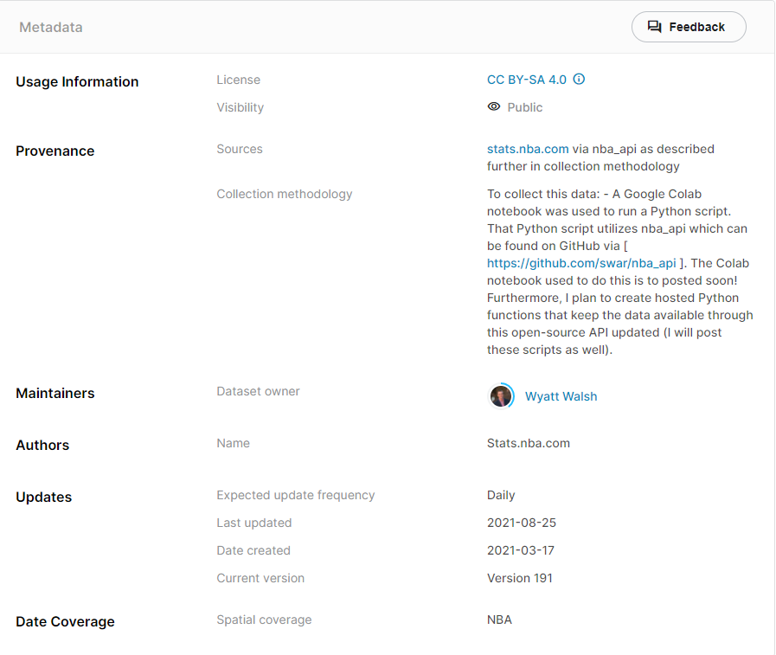
Data Information
Basketball Dataset from Kaggle which is sourced from stats.nba.com
Contains statistics information for more that 4500 NBA players

Slide 6
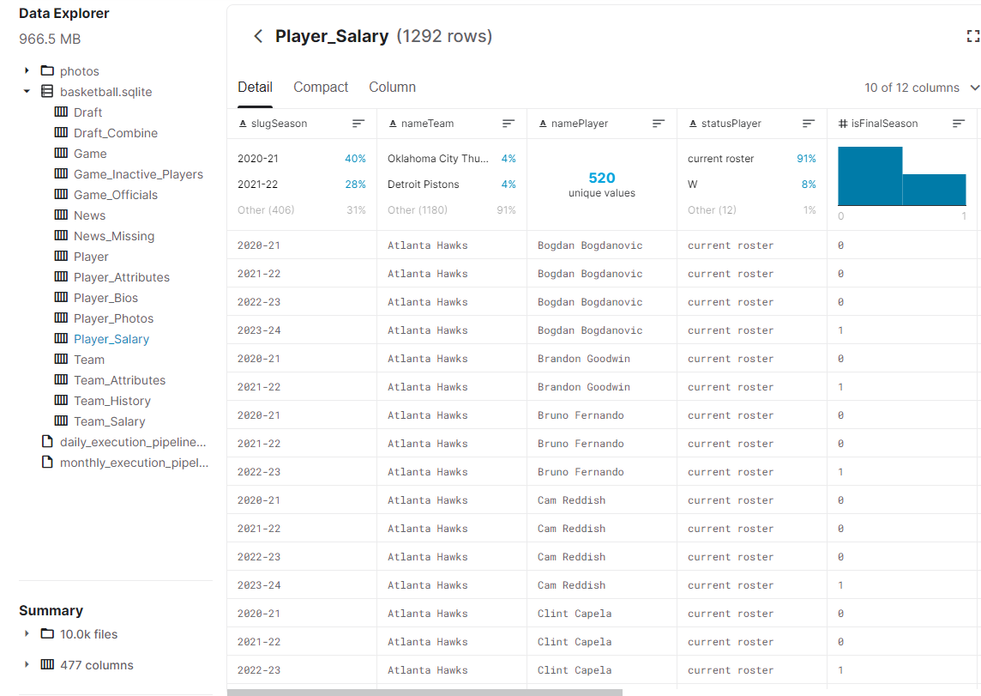
Data Wrangling – Part 1
Query information from SQLite database
Interested in Table “Player Attributes” and “Player Salary”

Slide 7
Join Tables
Table “Player_Attributes” has 4500 rows and 37 columns data. Each row is one player, and each column is the player’s attributes such height, weight, season experience, average points, assists and rebounds.
Table “Player_Salary” has 1293 rows and 12 columns data. Each row contains each player’s current season salary and future seasons salary.
Join the tables together by player name and grouped salary together using the average
The combined table has 4500 rows and 40 columns.

Slide 8
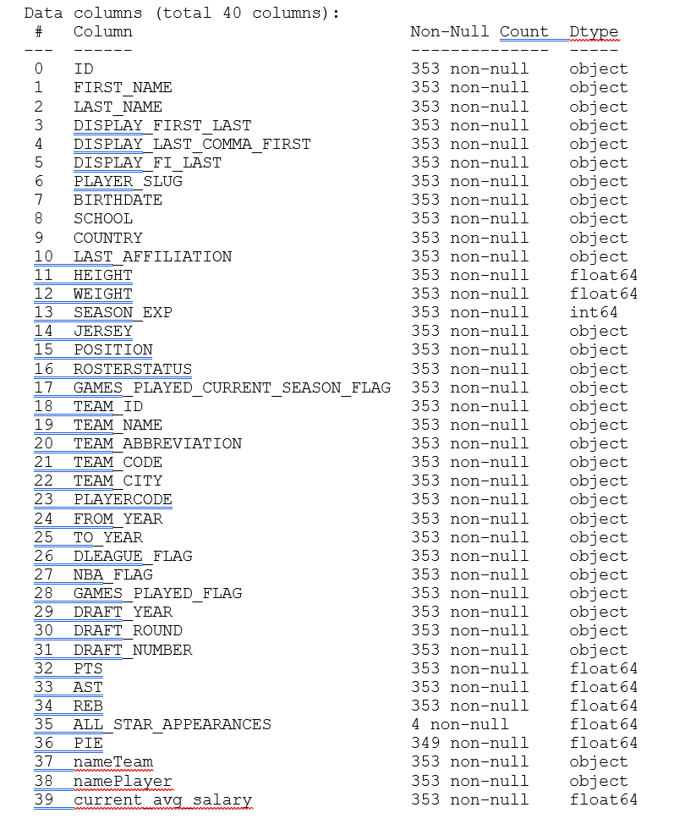

Slide 9
Data Cleaning
1. Dropped the ‘ALL_STAT_APPEARANCES’ column that only has 4 non-null value.
2. Fill null values of PIE column with average
3. Converted player’s birth to age, then drop the birthday column
4. Use ‘TO_Year’ column minus ‘FROM_year’ column to calculate how many years the player played and named it ‘SEASON_EXP’
5. I dropped the columns that obviously did not relate the salary such as 'ID', 'FIRST_NAME', 'LAST_NAME', ect.
6. Finally, the clean data has total 18 columns that contains all potential salary related player attributes and player performance.

Slide 10
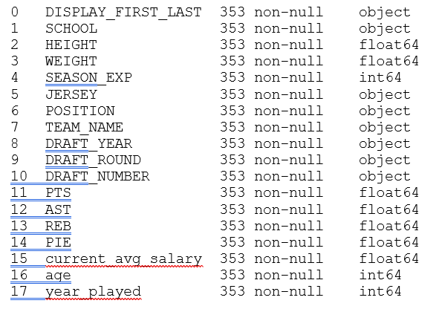

Slide 11

Data Exploratory Analysis

Slide 12
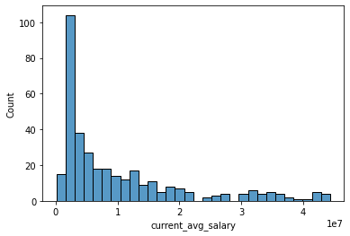
Data Exploratory Analysis – Part 1
plotted histogram the salary to see the distribution.
non-normal distributed instead it is right skewed
which makes sensor by knowing the start players high salary then non-start player

Slide 13
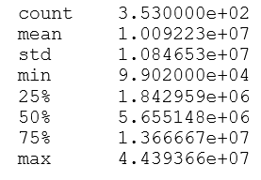
Salary Information
Average salary is about 10 million, but the median salary is only about 5.6 million. The standard deviation is about 10.8 million

Slide 14
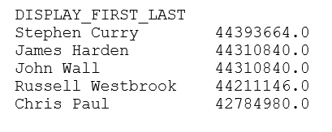
Top Five Highest Salary Players

Slide 15
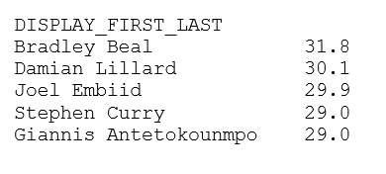
Top Five Highest Score Point Players

Slide 16
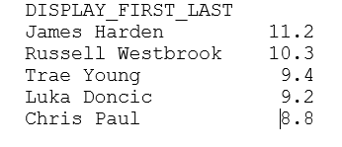
Top Five Highest Score Points Players

Slide 17
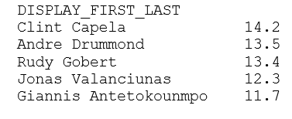
Top Five Highest Rebounds Players

Slide 18
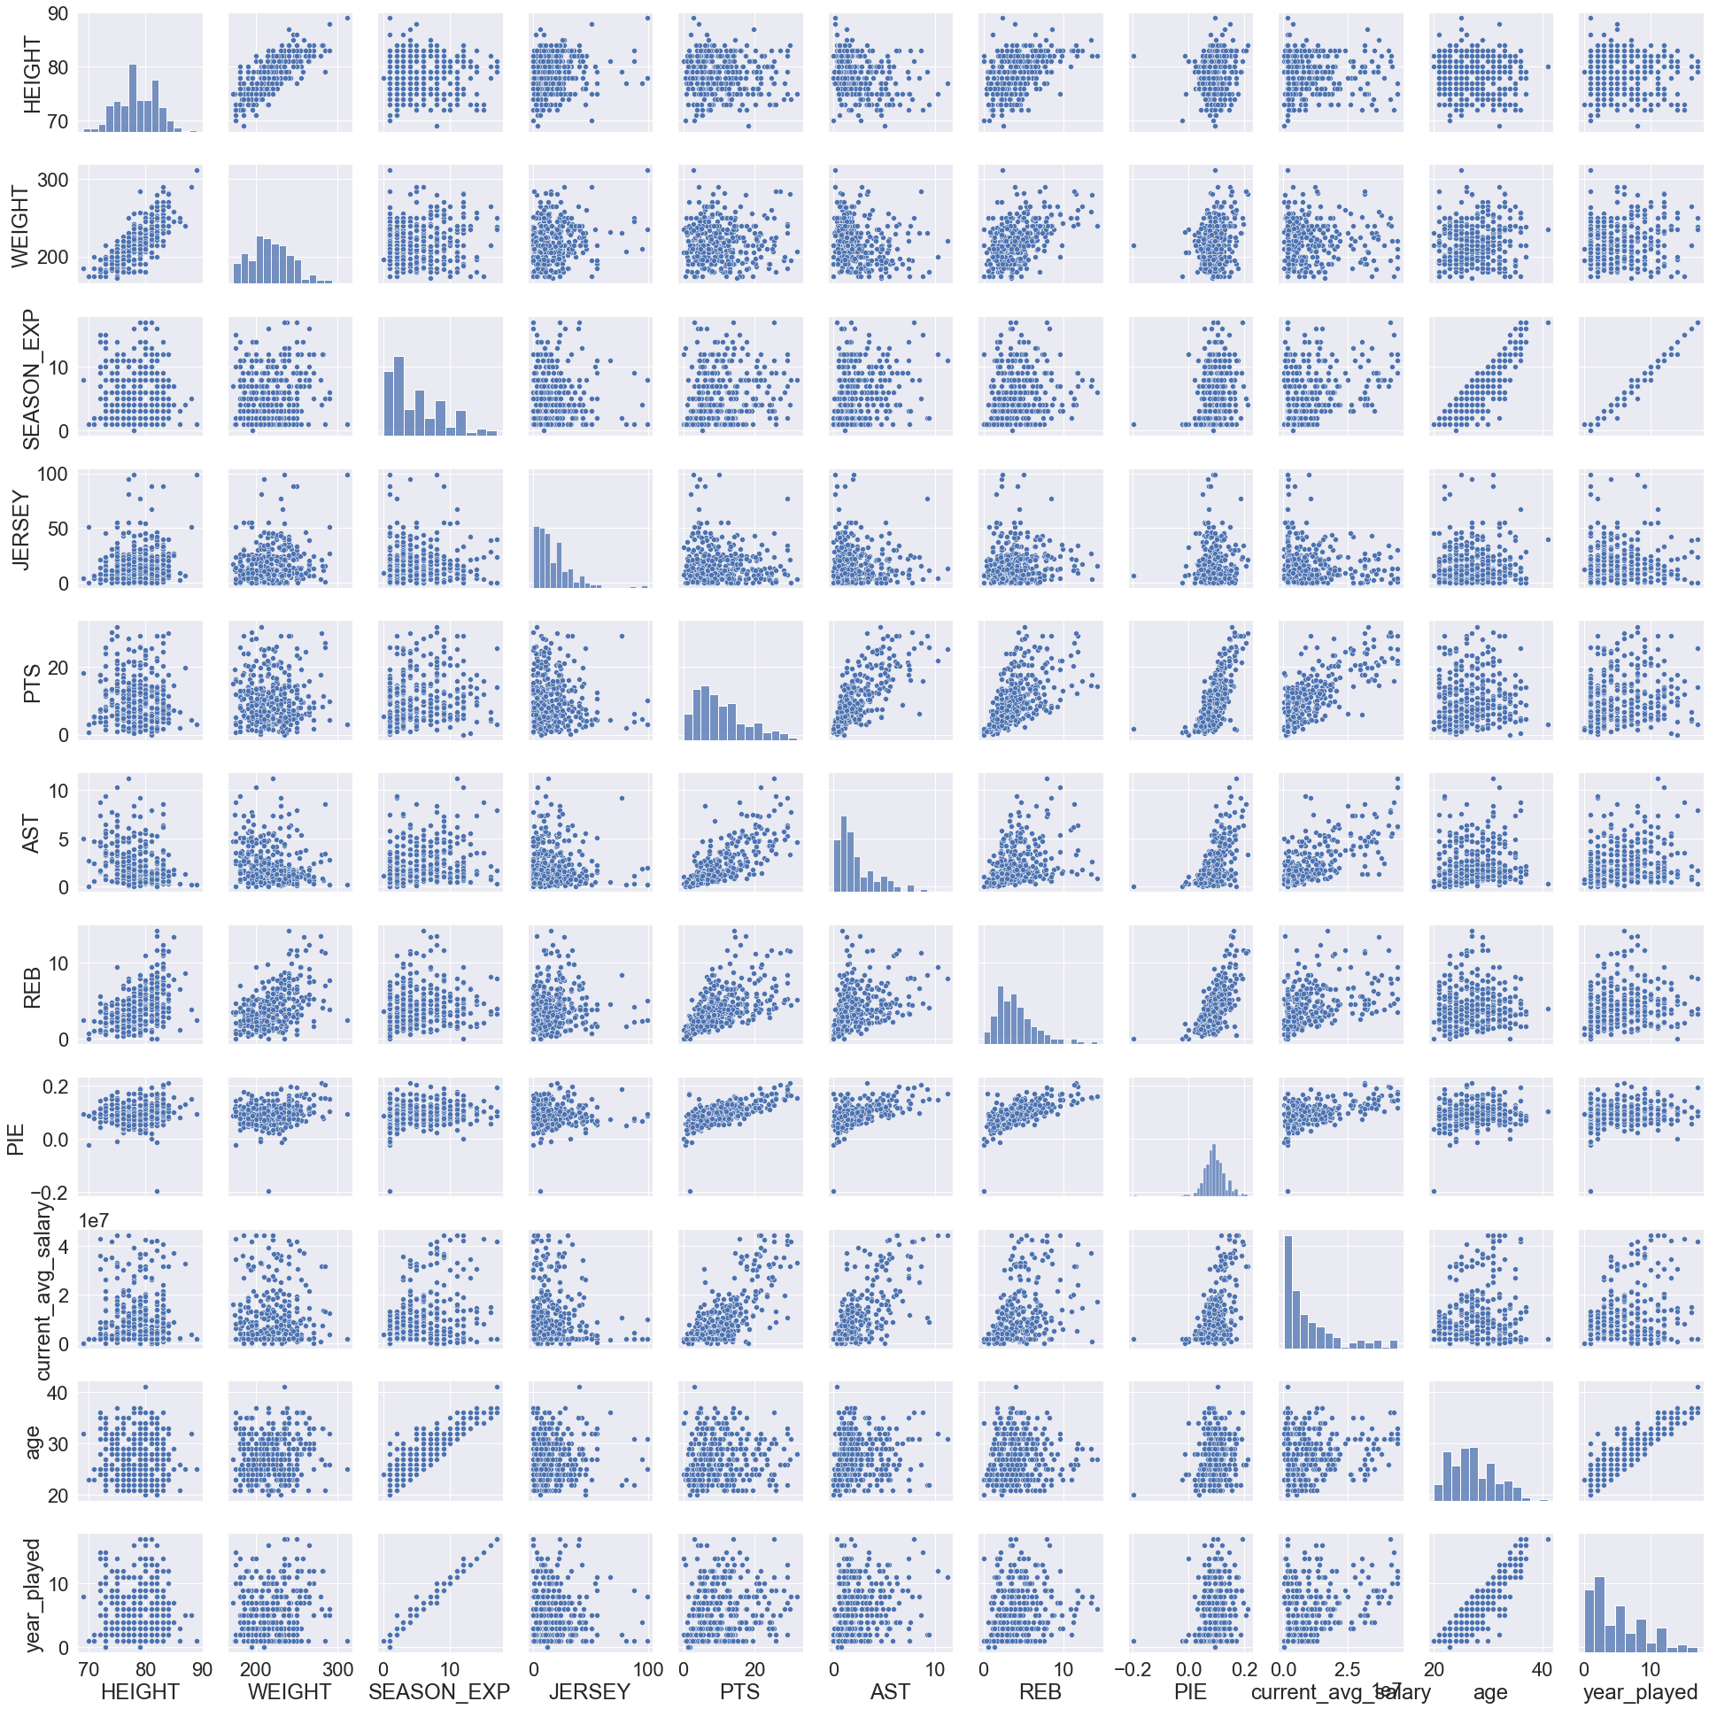

Slide 19
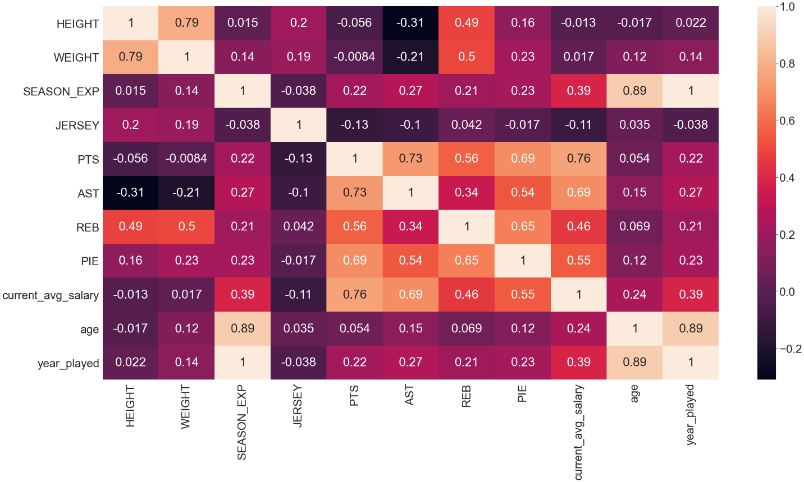

Slide 20
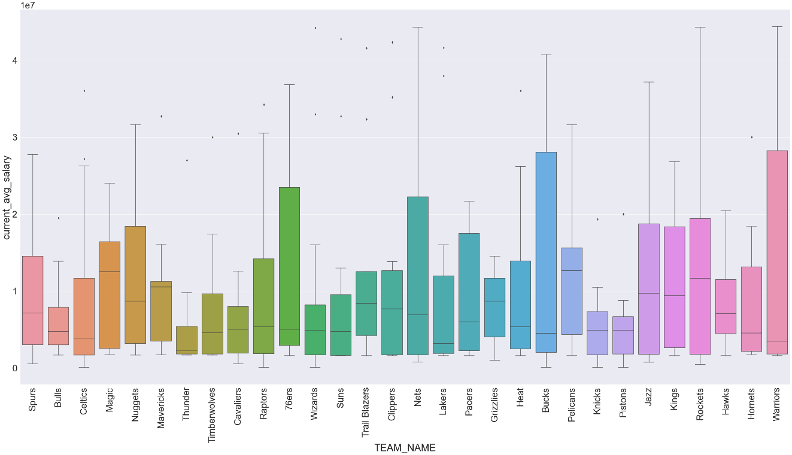
Team vs Salary
Most team have one to two outliers

Slide 21
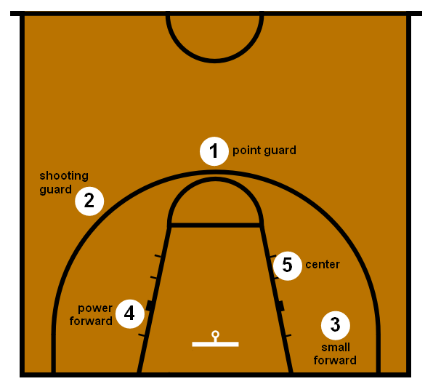
Position vs Salary
There are 5 positions: center, power forward, small forward, point guard and shooting Guard.

Slide 22
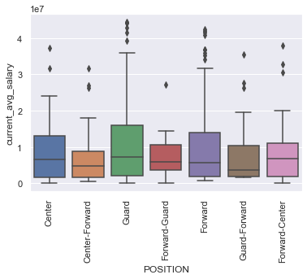
Position vs salary
Guard has the highest average salary which makes sensor if score points, and assist are the most important features to determine salary

Slide 23
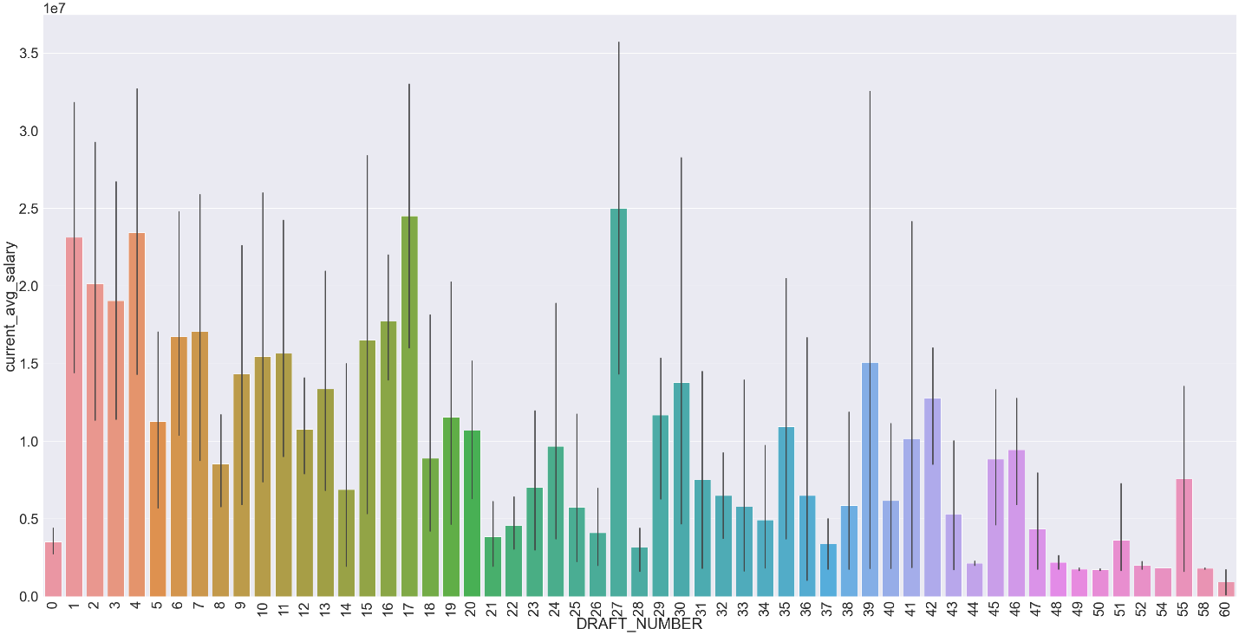
Draft number vs salary
The NBA draft is an annual event which the teams from NBA can draft players who are eligible and wish to join to join the league. Typically, the player has draft number 1 is the best player in the draft
In the graph, 0 means un-draft, 1—4 have very high salary, but 5 is relatively low, and interestingly 17 and 27 are the highest

Slide 24
Pre- processing and Training Data Development

Slide 25
Create dummy features
Since I am going to use regression models to analyze the data
I created dummy features for all the categorical values such as team name, position, draft number and school
After creating dummy feature, total columns become 190

Slide 26
Scaling
Since the scales for numerical values are different and values are all positive.
I used ‘MinMaxScaler’ to standardize the magnitude of the numeric features

Slide 27
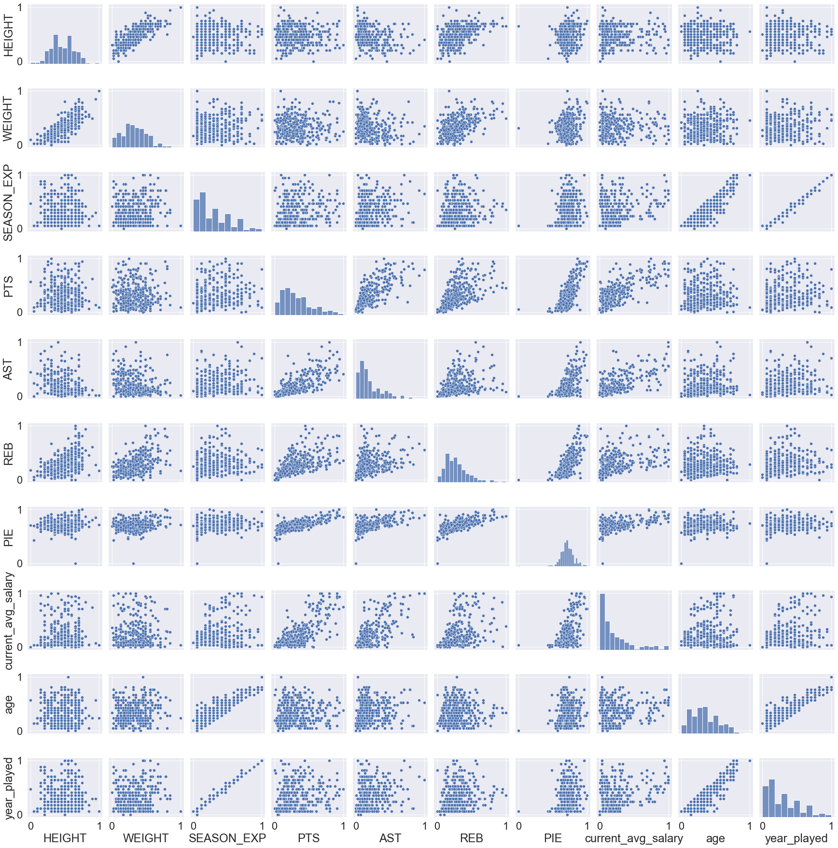
Pair plot after scaling

Slide 28
Model Selection

Slide 29
Three Models
Linear Regression
Random Forest Regressor
KNN regression

Slide 30
Linear Regression
First, fit the model with all the features, but it turned out overfitting
The mean absoluter error for train set is 0.0077, but for the test set is 4.7e+19. The evaluation metric shows the model doing good to predict train data, but very poor on the test data. It is clearly overfitting
Next step, reduce fitting features

Slide 31
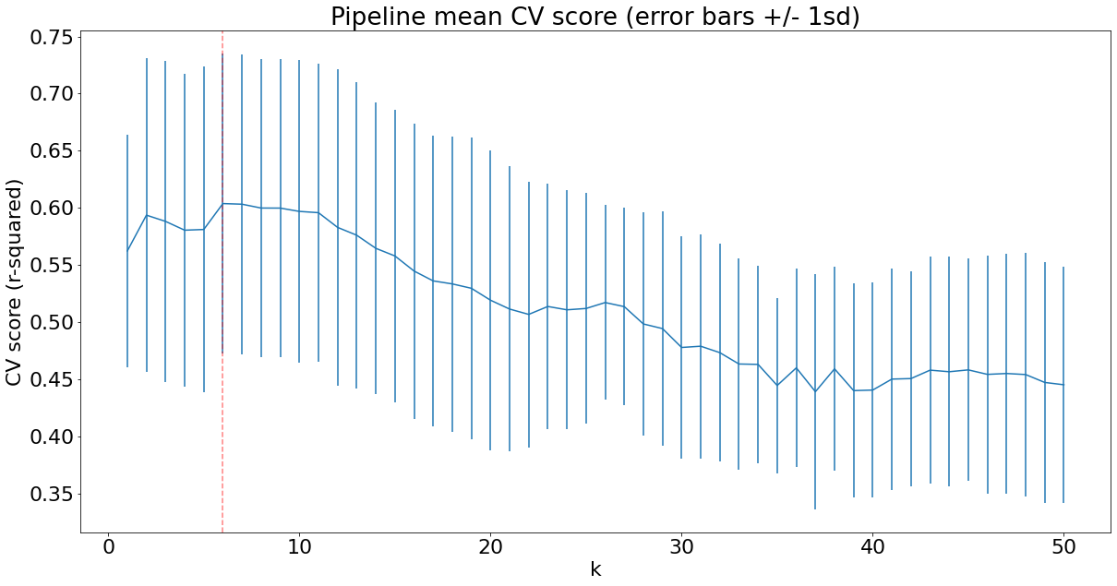
Best Feature selection
Created a pipeline including ‘Selectbest’ as s step, then used grid search cross validation to get the best K
The graphs has shown the best k is 6 which means use the top 6 features to fit model will be the best

Slide 32
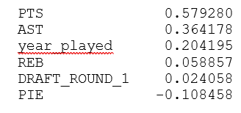
The top 6 features
The most important feature is points scores
Second is assist
Interestingly year_platyed is the third one has much heavier weight then rebound

Slide 33
Random Forest Regression
The best params for the model is max depth is 5 and n_estimators is 112.

Slide 34
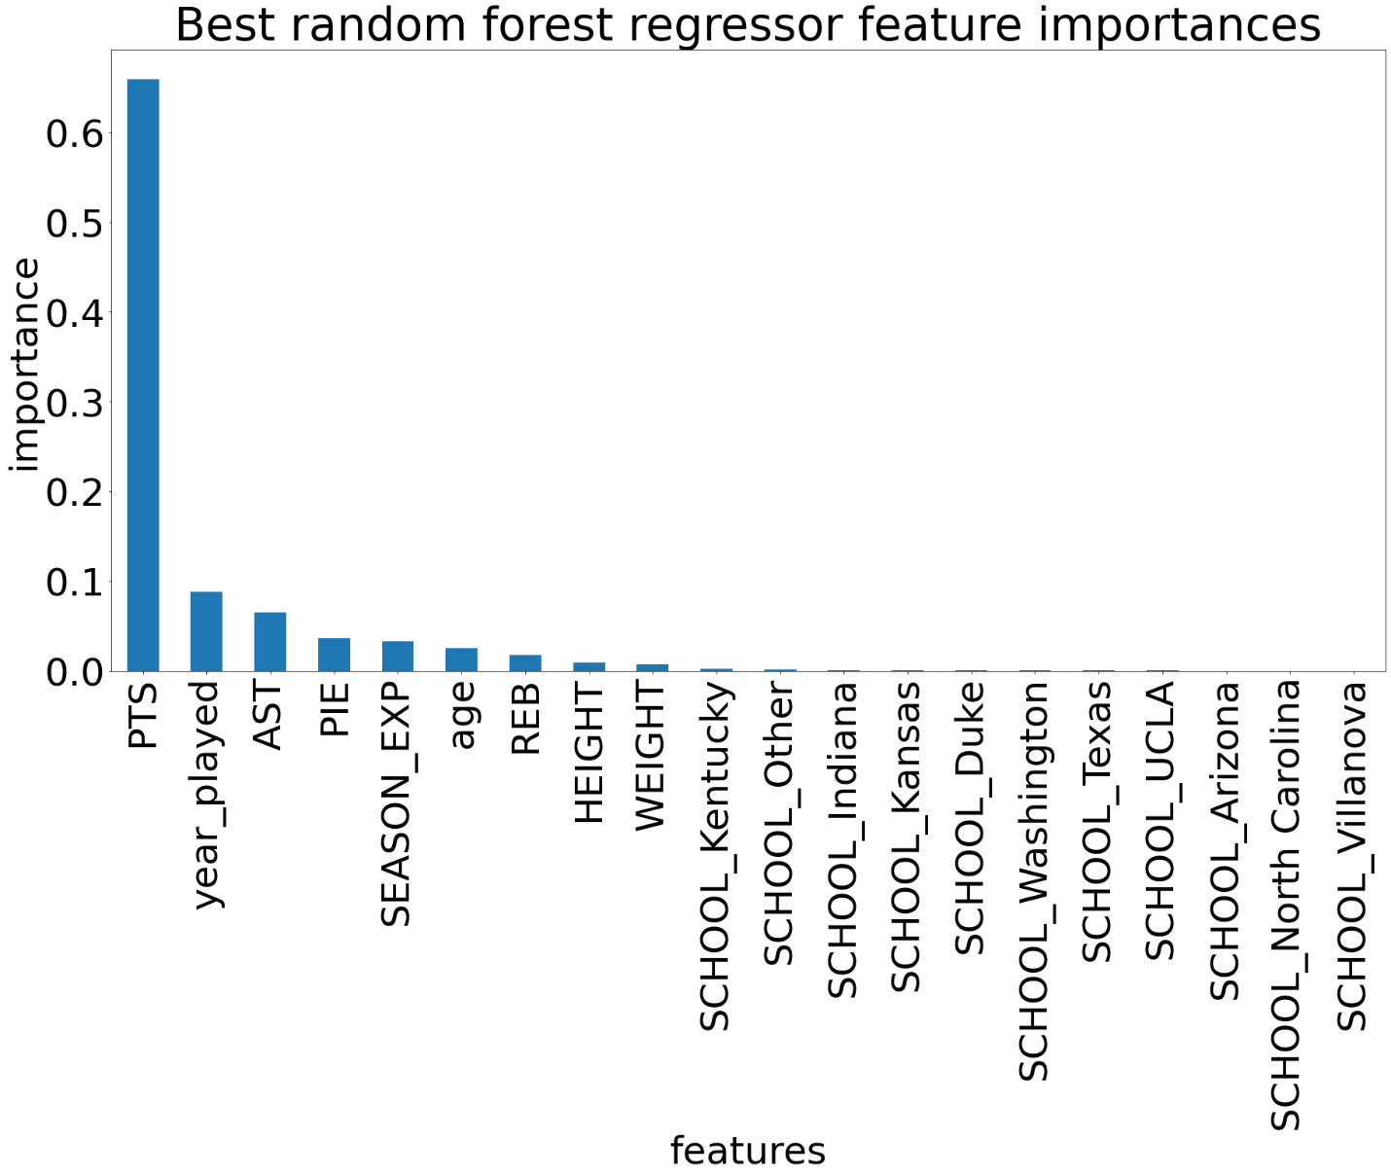
The Most Importance Features
Point scores is the most importance feature same as linear model
However, second most importance feature is year_played instead of assist

Slide 35
KNN regression
The best parameter for the model is 13 neighbors and uniform weights.

Slide 36
Model Comparison
Model | Mean absolute error | Error in dollar
Linear regression | 0.0978 | 4341291
Random forest regression | 0.0796 | 3535549
KNN regression | 0.1191 | 5287359
Dummy | 0.1862 | 8265866
Random Forest regression model has the best performance.
Its mean absolute error 0.0796 which scaled it back to salary is about 3.5 million.
Given that the averages salary is about 10 million, the error is about 35%
it is not best model, but its performance is 47% better than a random guess dummy model

Slide 37
Extract Step
Since models did not output the best result, I thought it could the data I used to fit the model cause the problem. I think the outlier maybe the problem. Recall that outlier are the star players who have extremely high salary compared to their teammates.
My hypothesis is that only star players’ salaries are not only depends on their course performance and attribute but affected by the player’s popularity and non-game issues.
To test my hypothesis, I drop the star players from the dataset. Since the salary is right skew distributed, I used 90% confidence interval to separate the data. Within 90% is non-star player, outside of 90% is star player. After dropping the 5%-star player, the data frame has total 317 rows, 36 players are dropped.

Slide 38
Models fit with non star data
With Non-Star Data
Model | Mean absolute error | Error in dollar
Linear regression | 0.0898 | 3986755
Random forest regression | 0.0730 | 3241510
The best model is still random forest regression
The error become smaller from 3.5 million to 3.2 million, but average salary also decreased as the outliers are dropped to about 7 million. Therefore, is the error increased to about 46%.
The model is did not become better but worse.
One reason could be the less data ware used to fit the model

Slide 39
Future Research
Not enough data:
The data set I used to fit the model only have 352 rows which is not too much.
The data set do not contain the player passed year salary. I think more salary information will help improve the model.
Other factors that will affect player salary and did not include in the data set I am using :
I did some more research after this project and noticed salary cap could be a factor that affect player salary and there could be more
Try categorical model:
I would like tested categorical model in the future. Which I will separate the salary into difference categorical such lower, below average, average, above average, high and super high.

